Slide 1
Activity-based Early Autism Diagnosis Using A Multi-Dataset Supervised Contrastive Learning Approach [1]
Authors: Asha Rani, Yashaswi Verma
IIT Jodhpur, India
Arnar Gylfi Haraldsson
arnarh23@ru.is
T-869-COMP

Slide 2
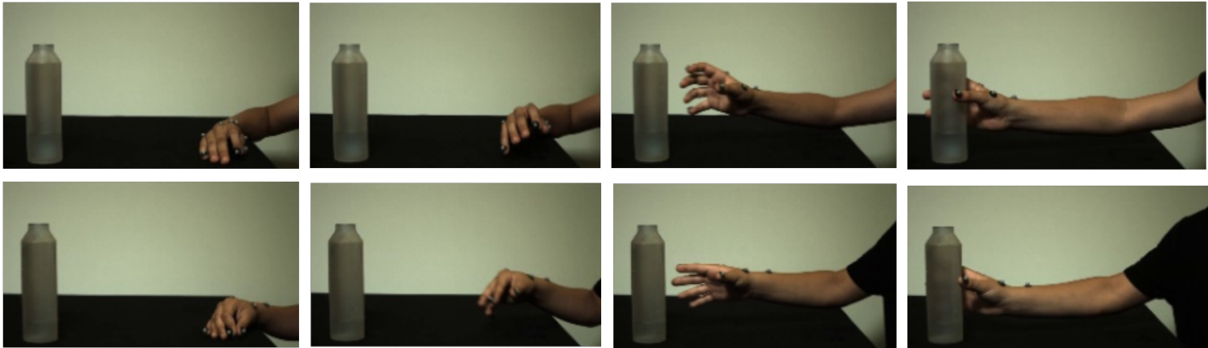
Problems
Traditional ASD diagnosis is time consuming
Limited training data
Low inter-class variability
Lack of clear feature understanding
Figure 1: Test subjects grabbing a water battle (ASD on the top, control on the bottom) [2]
Notes:
Traditional methods of diagnosing autism spectrum disorder require multiple visits to specialists, which can be time-consuming and delay early intervention. The authors sought to use machine learning on video clips to facilitate quicker diagnosis.
To do this the authors needed to overcome more Technical/Machine Learning Challenges:
Limited Training Data: The available datasets for ASD diagnosis are generally small, containing only a few hundred samples.
low inter-class variability: The videos from the two categories (ASD and Control) are often perceptually indistinguishable
Lack of Clear Feature Understanding: There is no clear understanding of which features are beneficial for distinguishing between ASD and Control categories

Slide 3
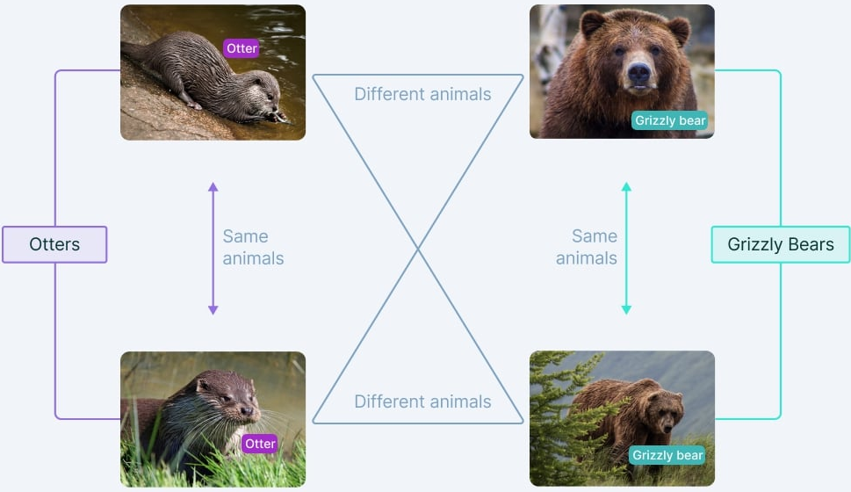
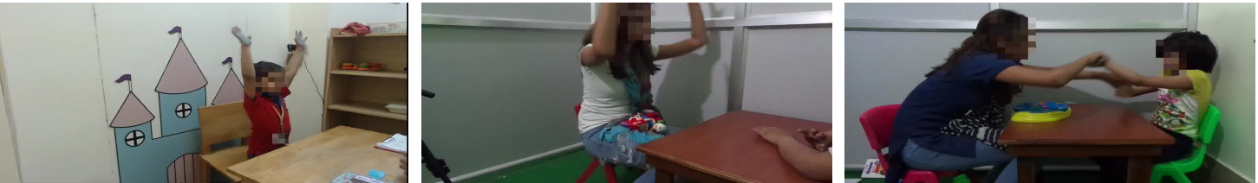
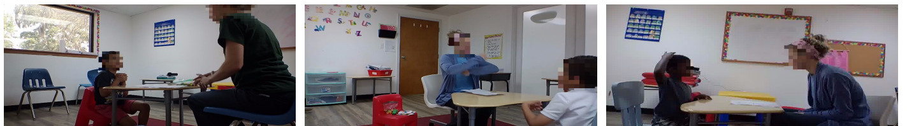
Methods
Two datasets
Hand Gesture dataset [2]
Autism dataset [3]
Supervised Contrastive Learning
Pair generation
Deep feature encoder network
Multi-Dataset Supervised Contrastive loss (novel)
Figure 3: Contrastive learning diagram [4]
Figure 2: Autism dataset, test subjects imitating movements of clinician [3]
Notes:
Methods that were used to address these problems. The authors used two datasets. One of them is the hand gesture dataset which contains video recordings of four activities for example pouring a waterbottle or passing a waterbottle each performed multiple times by 39 subjects. According to the paper this was a challenging dataset because it had low inter-class variability.
And what the authors call in the paper the autism dataset. It contains recordings of children imitating one of eight activities of a clinician such as locking hands, and touching the head.
The core of their methodology is based on supervised contrastive learning. Contrastive Learning is a Machine Learning method where unlabeled data points are juxtaposed against each other to teach a model which points are similar and which are different.
For each video in the datasets, the authors created a positive pair by pairing it with a video from the other dataset that belongs to the same category, and they also create a negative pair by pairing it with a sample from the other dataset that belong to a different category, creating cross-dataset pairs.
Pairs of videos were then passed to feature encoder networks to extract meaningful features, which were then transformed into embeddings (compact, meaningful representations of the videos) that can be compared.
To learn the parameters of this network, the authors proposed a novel multi-dataset supervised contrastive loss function, which is the main contribution of the paper. This loss was then minimized using a gradient descent approach.

Slide 4
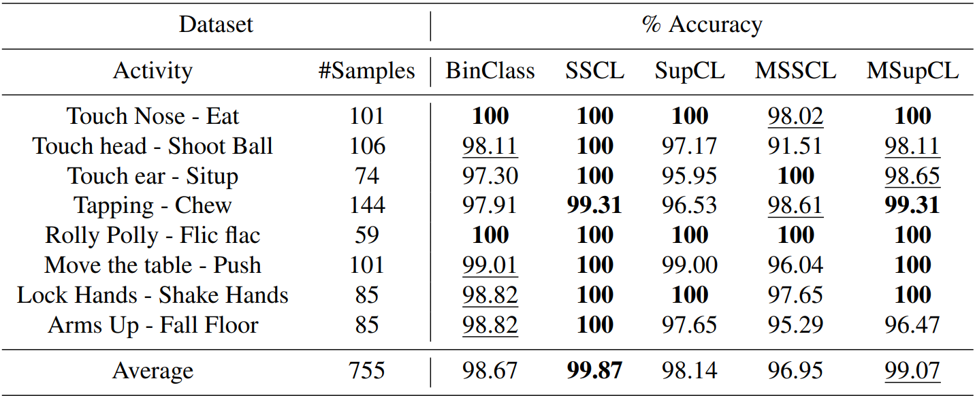
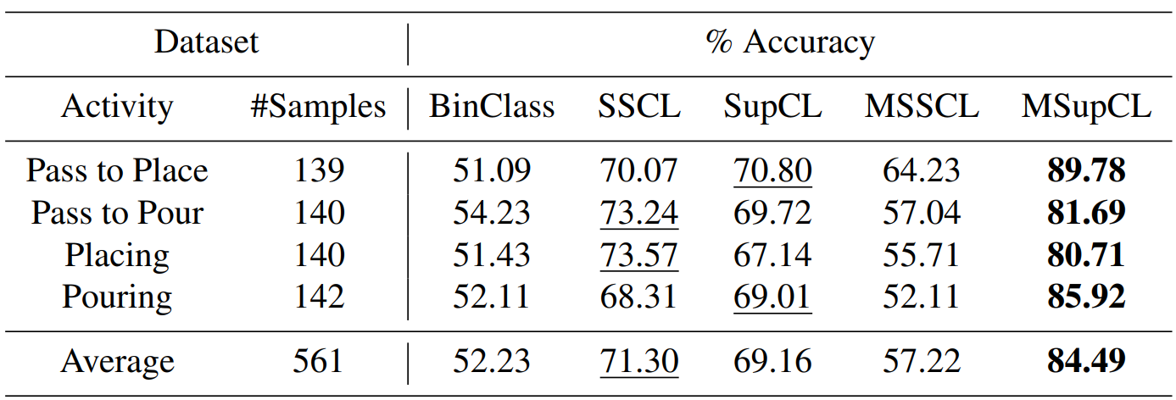
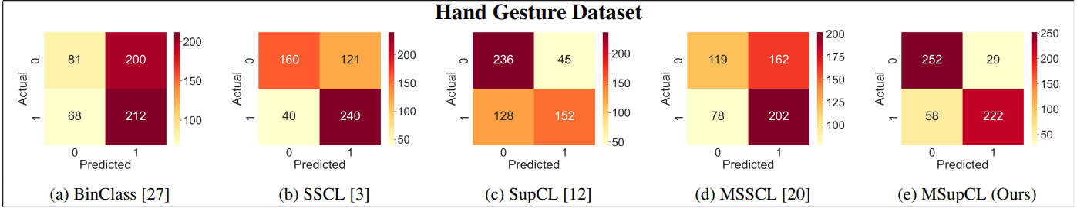
Results
Notes:
To evaluate the effectiveness of the proposed approach, the authors compared it with competing contrastive learning techniques. uni-modal self-supervised SSCL, uni-modal supervised SupCL [12], and the multi-modal self supervised MSSCL. A standard deep classifier (BinClass) is also used as a baseline.

Slide 5
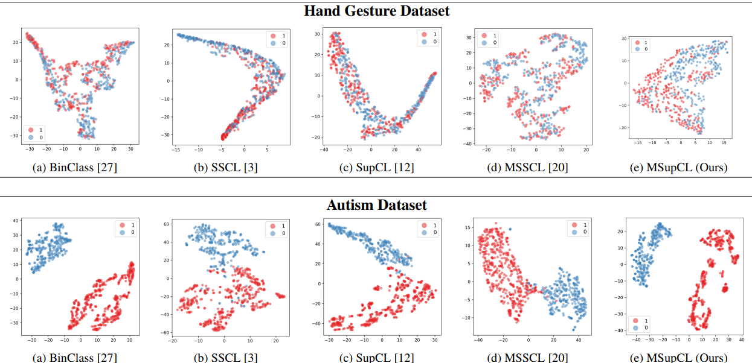
Notes:
t-distributed stochastic neighbor embedding, which is method for visualizing high-dimensional data by giving each feature a location in a two dimensional map. As you can see the Hand Gesture Dataset

Slide 6
Main contributions / Why it matters
Novel Multi-Dataset Supervised Contrastive Learning Approach:
Addressing small datasets and Intra-Class and Inter-Class Variability
Can be beneficial to other fields with similar data limitations.
Notes:
The main contribution of this paper is introducing this novel multi-dataset supervised contrastive learning approach, which can help to achieve a greater accuracy when dealing with smaller datasets with intra-class and inter-class variability by integrating knowledge from two diverse and independently collected video datasets.
This approach extracts task-specific knowledge from the easy dataset to the model trained for the difficult dataset and improves its accuracy,
The superiority of this technique over others was demonstrated, and it may be beneficial in other health-care related tasks that suffer from the same data limitations.

Slide 7
References
[1] A. Rani and Y. Verma, "Activity-Based Early Autism Diagnosis Using a Multi-Dataset Supervised Contrastive Learning Approach," in Proceedings of the IEEE/CVF Winter Conference on Applications of Computer Vision (WACV), Jan. 2024, pp. 7788–7797. [Online]. Available: https://openaccess.thecvf.com/content/WACV2024/papers/Rani_Activity-Based_Early_Autism_Diagnosis_Using_a_Multi-Dataset_Supervised_Contrastive_Learning_WACV_2024_paper.pdf
[2] A. Zunino, P. Morerio, A. Cavallo, C. Ansuini, J. Podda, F. Battaglia, E. Veneselli, C. Becchio, and V. Murino. Video gesture analysis for autism spectrum disorder detection. In IAPR International Conference on Pattern Recognition, 2018.
[3] Prashant Pandey, A P Prathosh, Manu Kohli, and Josh Pritchard. Guided weak supervision for action recognition with scarce data to assess skills of children with autism. In AAAI Conference on Artificial Intelligence, 2020.
[4] R. Kundu „The Beginner’s Guide to Contrastive Learning”. v7Labs.com. https://www.v7labs.com/blog/contrastive-learning-guide

